Slide 1


Playing With Netflix Dataset
ISTE Approved
Free One WEEK Online WORKSHOP on
"Joy of Programming using Python"
Dates: (April 25-May 1, 2020)
Organized by
Computer Engineering Department, C.K.Pithawala College of Engineering & Technology, Surat, Gujarat State, India.
Mr. Nishant M. Gandhi
Enrollment no:111111
College: CKPCET, Surat
email:(nishantgandhi99@gmail.com )
Dr. Ami T. Choksi
Enrollment no:4444
College: CKPCET, Surat
(ami.choksi@ckpcet.ac.in)

Slide 2


Group Members:-
Shekh MehmoodHomam Tarikulislam
College : S.V.M.I.T. Bharuch
smhomam333@gmail.com
Patel Sajedabanu Hasmatali
College : C.K.Pithavala college of Engineering and Technology, surat
sajedapatel020@gmail.com

Slide 3
Netflix dataset
This is basically a dataset that we took from Kaggle datasets. It is based on Netflix
In this dataset it has categorized the data of Netflix on the basis of rating, cast, director, year, type etc.
We chose this set to implement our function taught in workshop and to see the outcome .

Slide 4
Data Processing 1
In this Netflix data set we tried to get info of all the data set.
Also we transposed the data set.
In this data set we have used some filters search such as from year range, on the base of duration, type of content etc.
Also we counted the types of movies and tv show
We collected info of type of data present in Netflix such as movie , tv show

Slide 5
Data Processing 2
We also even arranged the data in ascending order with respect to release time of that movie or tv show
We even tried to deep filter the documentary section
Ex: year wise release, duration wise, arranging in ascending order on the base of release year etc.
So above were some of the functions which we implemented in this dataset of Netflix

Slide 6
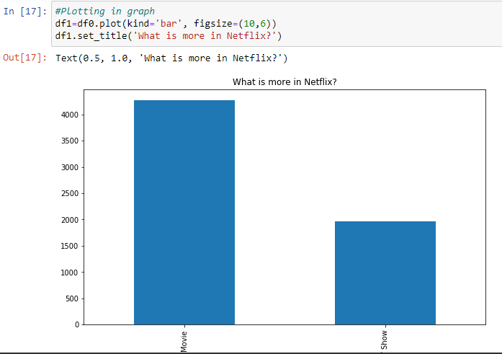
Graph Plotting 1
This graph shows what is more in Netflix means either movie or tv show .
This is bar graph .
According to dataset we have got for Netflix it has concluded that movies portion is more.

Slide 7
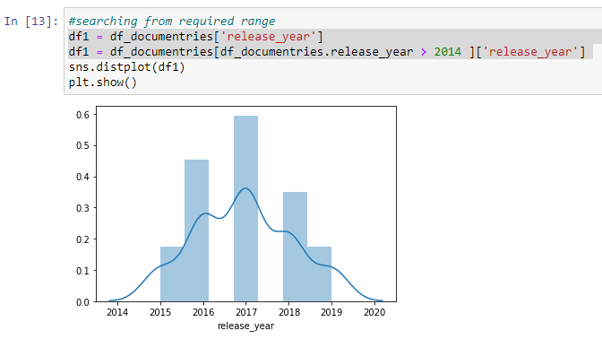
Graph Plotting 2
Graph for detailing info according to year
As you can see the graph is plotted with respect to year for documentaries of Netflix
We have included one filter more that we need from year 2014 hence the graph displays from 2014 year
From fig easily it can be concluded that in year 2017 the documentaries have been released more.

Slide 8
Thanking
At last finally we enjoyed playing with this dataset
We enjoyed the implementation of all those things which we were taught during workshop lectures.
We learnt the basic python that too in such a short span time .
We Thank both faculty for being helpful to us and making us learn something new .

Slide 9
THANK YOU!!!

